Slide 1
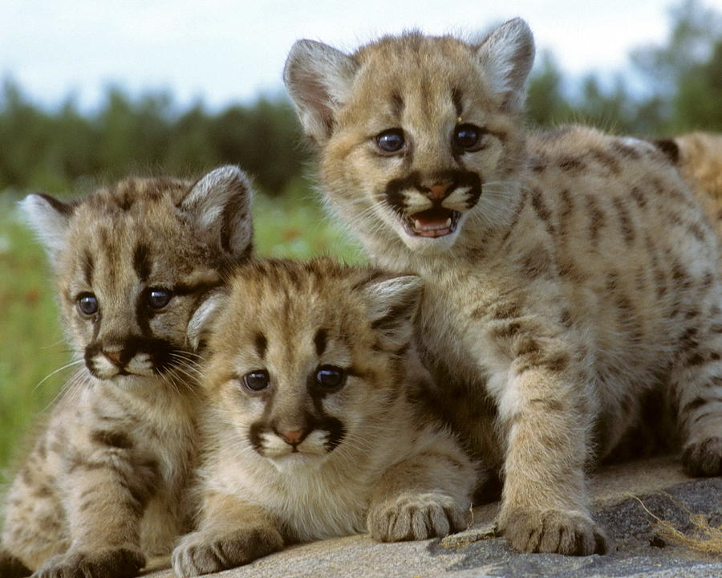
Agenda
Introduction to Counseling
Counselor Alpha Breakdown
Counselor Role, Confidentiality & Safe2Tell
How to Schedule an Appointment
Effective Communication w/Adults
Practice writing an email
Resources
ICAP
Curriculum breakdown
District Values
Ikigai
Field trip to Counseling Office

Slide 2
Introduction to Counseling
A-Bri | Ms. Debard
Bro-D | Ms. Krueger
E-Ha | Ms. Riley
He-I | Ms. Gillespie
J-K | Ms. Gabrielli
L-Mom | Ms. Carpenter
Mon-Re | Mr. Witte
Rh-S | Mr. Martinez
T-Z | Mr. Jasurda
GT A-K | Ms. Bowden
GT L-Z | Ms. Crook
Support you in 3 domains:
Academic, Career, Social/Emotional Development
Confidentiality
Download the Safe2Tell App, also can be found on the back of your student ID
https://safe2tell.org/
Notes:
3 conditions we have to break confidentiality: harm to self, harm to others, someone harming you or someone else

Slide 3
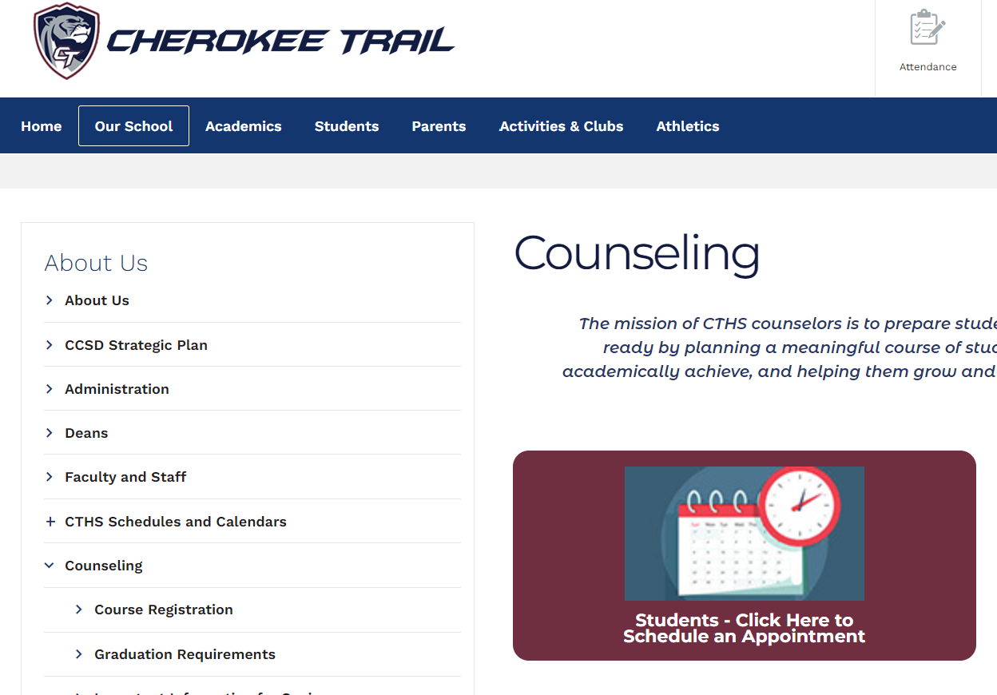
How to Schedule an Appointment with your Counselor
Got to the CT website
Click Our School
Counseling
Schedule an Appointment
Click here to schedule an appointment
Notes:
Only schedule an appointment with you assigned counselor
If you can’t find a time, please email then

Slide 4
Effective Communication
Subject Line:
"Grade Concern"
Greeting:
"Hello Mr. Favorite Teacher"
Conversation Starter:
"I'm contacting you regarding....(missing exam, HW extension, class grade, confusion, etc.)"
Direct Request:
"Is there a time we can connect to discuss.....(when to make up the exam, my late work, etc.)"
Gratitude/Closure
"I understand that you are busy and appreciate your attention to my request. Thank you.”
Sincerely/From:
"Hardworking Henry"
Access your Cherry Creek school email through My.CherryCreek then clicking on the Microsoft Outlook Tile
Notes:
Practice writing an email

Slide 5
Resources
Cougar Resource Center (CRC)
Peer tutoring center with adult support. Open every period during the school day, just drop in!
Student Access Support
Before school Mondays & Wednesday 7:45-8:15 AM
*Your classroom teacher is the best resource to start with!

Slide 6
ICAP at CTHS
ICAP is a multi-year process that intentionally guides students and families in the exploration of career, academic and postsecondary opportunities. With the support of adults, students develop the awareness, knowledge, attitudes, and skills to create their own meaningful and powerful pathways to be career and college ready.
(Colorado Department of Education)
Curriculum Timeline
Freshman: Learning Styles, Personality Types, Career/Course Pathways
Sophomore: Career Interest Inventory, Personality Inventory, Post-Secondary options
Junior: Planning for your career pathway & researching Post-Secondary plans
Senior: Fulfill your Post-Secondary Plan
I-Individual: Specific to the student's unique interests, skills, and talents
C-Career (and): Identifying a career path that fits the individual student
A-Academic: Identifying the skills and education necessary to reach that career path
P-Plan: Creating a meaningful pathway that allow students to reach their career & academic goals

Slide 7
Core Values
We believe in developing our abilities through hard work and dedication to continuous improvement. Do difficult things, venture outside your comfort zone, and embrace mistakes as opportunities to grow.
We want to encourage curiosity and investment in learning so that students feel seen and valued.
It is our role to help break down barriers to provide fair access to all students. We want to provide a supportive environment where you can be you.
We believe in the power of relationships in helping students grow and thrive.
We want you to be healthy, safe, engaged and supported. Our focus is on your mental, physical, emotional and social needs.

Slide 8
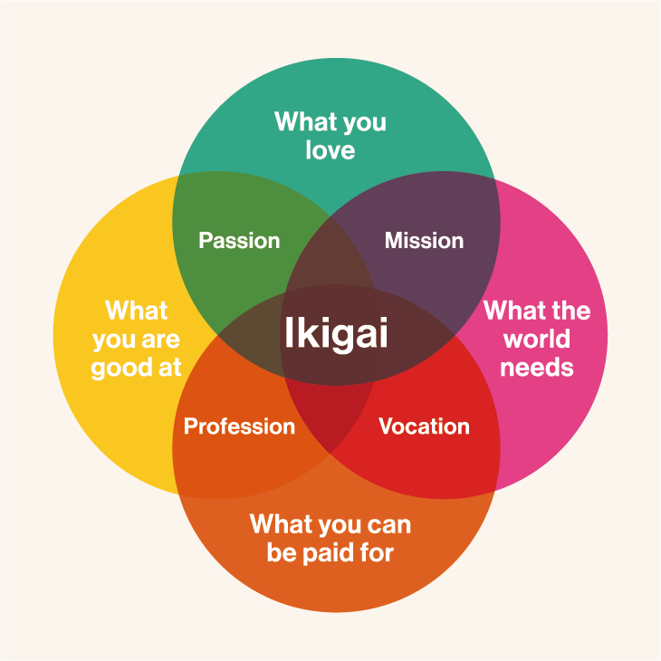

Slide 9
WE ARE CT!!

